Slide 1


Cost architecting for Windows Azure
Maarten Balliauw http://about.me/maartenballiauw http://blog.maartenballiauw.be @maartenballiauw

Slide 2




Who am I?
Maarten Balliauw
Antwerp, Belgium
www.realdolmen.com
Technology Specialist Windows Azure
Co-founder of AZUG
Focus on web
ASP.NET, ASP.NET MVC, PHP, Azure, …
MVP ASP.NET
http://blog.maartenballiauw.be
@maartenballiauw

Slide 3
Agenda
Different metrics
Easing the bill
Virtual machines
Storage
SQL Azure
Customer awareness
Developer awareness
Takeaways
Q&A

Slide 4
Different metrics
Traditional architecture vs. Cloud architecture

Slide 5
CapEx (classic investment model)
Allocated IT-capacities
Load Forecast
Undercapacity
Overcapacity
Fixed cost of IT-capacities
IT CAPACITY
Investment
Actual Load
TIME

Slide 6
OpEx (“pay for use”)
Load Forecast
Allocated IT capacities
No undercapacity
IT CAPACITY
Reduction of overcapacity
Possible reduction of IT-capacities in case of reduced load
Reduction of initial investments
Actual Load
TIME

Slide 7
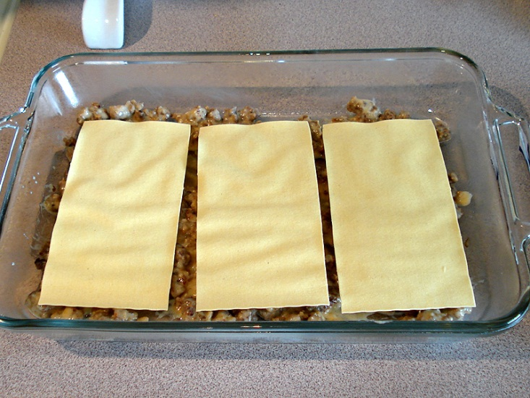

That’s a challenge!
Traditional architecture
Overcapacity available
Extra layers != extra costs
Costs are hidden
Cloud architecture
No overcapacity
Extra layers == extra costs
Costs are visible*
vs
Notes:
Hidden costs in traditional IT!

Slide 8
You pay for ...
the services used
Windows Azure
SQL Azure
Azure AppFabric
1. Compute
2. Storage
3. Storage Transactions
4. DB
5. Access Control Transactions
6. Service Bus Connections
+ the data transfer consumed
Outside the datacenter
DataCenter
7. ingress
8. egress

Slide 9
8 different parameters???
Typically you only use 4-5:
Compute hours
SQL Azure database
Storage
Data transfer in
Data transfer out

Slide 10
Complex?
No! Here are your datacenter parameters...
Licenses
OS License
SQL Server License
Hardware investment
Server
Disks
Racks
Switches
UPS
Network cables
Hardware maintanance
Power consumption of hardware
Server
Disk
Racks
Swithes
Insurance of hardware
Insurance on server room
Server room
Rent
Cooling
Lighting
Cleaning
Smoke detectors
Tapes for backup
Salary for admin people
Install hardware
Maintain hardware
Apply OS patches
Backup/Restore operations
Firewall/DMZ configuration
Clear logfiles
Taxes on Salaries
Time spent on procurement cycle of hardware / Licenses
...

Slide 11
Virtual Machines
Easing the bill

Slide 12
Limiting virtual machine count
Do you need full capacity 24/7?
Probably not, reduce # cpu’s when not used
Use Windows Azure Diagnostics API & Windows Azure Management API to scale (semi)-automatically
24 hours x 10 small instances = 20,50 EUR / day
vs.
16 hours x 10 small instances + 8 hours x 4 small instances = 16,4 EUR / day

Slide 13
Limiting virtual machine count
Staging environment costs
When not in use, undeploy the staging environment
24 hours x 5 small instances = 10,25 EUR / day
vs.
22 hours x 5 small instances = 5,13 EUR / day

Slide 14
&
Scaling from outside .NET
Using Cerebrata CmdLets to scale
http://www.cerebrata.com

Slide 15
Workers need work!
Out of the box, 1 worker role = 1 task
Why not spin up processes or threads?
10 tasks
1 task per worker = 20 workers*
2 tasks per worker = 10 workers*
10 tasks per worker = 2 workers*
Which means 41 EUR / day vs. 4,1 EUR / day
“Generic workers”: http://research.microsoft.com/en-us/downloads/76537edf-9b77-4664-b76b-cf51be506a0d/
* 2 instances minimum for the SLA

Slide 16
Combining work into one worker role

Slide 17
Do you need all of that?
Compute Instance Size | CPU | Memory | Instance Storage | I/O Performance
Extra Small | Shared 1.0 Ghz | 768 MB | 20 GB | Low
Small | 1.6 GHz | 1.75 GB | 225 GB | Moderate
Medium | 2 x 1.6 GHz | 3.5 GB | 490 GB | High
Large | 4 x 1.6 GHz | 7 GB | 1,000 GB | High
Extra Large | 8 x 1.6 GHz | 14 GB | 2,040 GB | High
1 XL = 2 L = 4 M = 8 S (regarding costs)
No need for this memory / disk space?
Stay with S or M
Scale up/down more granularly

Slide 18
Unemployed? Undeployed!
Billing per reserved VM
Reserved = deployed / running
Billing in staging and production
2 instances staging + 2 instances production = 4 instances billed
Undeploy your VM if not needed
Undeploy staging every evening
Automate this

Slide 19
Using Greybox for Windows Azure
http://greybox.codeplex.com

Slide 20


When the box is gray,
you’re okay.
When the box is blue
a bill is due.

Slide 21
Work per hour
Billed per clock hour / CPU
Keep instances running at least until x:55
Don’t deploy at x:50, instead deploy at x:55
Deploy at x:50 and undeploy at x+1:10
2 hours billed!
Don’t deploy every minute
= 60 instance hours per hour!
Don’t do continuous deployment for every build, but accumulate

Slide 22
Bandwidth, Storage & Transactions
Easing the bill

Slide 23
Bandwidth?
Belgians are used to being economical on this one...
Simple metric
Use more = pay more
Use less = pay less

Slide 24
When am I using bandwidth?
Data transfers in/out Windows Azure
Compute
Blobs
AppFabric
Data transfers between Windows Azure regions
E.g. North America – Europe
Keep compute & storage in the same region!

Slide 25
Content Delivery Network
Content distributed across X servers
Storage costs = Storage costs for public containers x 2
Bandwidth costs = # data in public containers x X servers
Can be limited by setting cache headers

Slide 26
Storage
Data you store (non SQL)
Tables
Blobs
Queues
Per GB / month
Average over full month
10 GB stored for 15 days, 0 GB stored for 15 days = 5 GB stored for 1 month

Slide 27
Transactions
1 transaction = 1 storage operation
Billed per 10.000
Checking a queue every second from 2 workers
172.800 transactions / day
Use a back-off mechanism
No data? Wait a second
Again no data? Wait two seconds
Etc.

Slide 28
Backoff polling a queue

Slide 29
Backoff polling a queue
Processed: Message #49 from a batch of 55
Processed: Message #50 from a batch of 55
Processed: Message #51 from a batch of 55
Processed: Message #52 from a batch of 55
Processed: Message #53 from a batch of 55
Processed: Message #54 from a batch of 55
Backing off for 1 second(s)...
Backing off for 2 second(s)...
FillQueue finished.
Backing off for 3 second(s)...
FillQueue is doing work.
Processed: Message #0 from a batch of 5
Processed: Message #1 from a batch of 5
Processed: Message #2 from a batch of 5
Processed: Message #3 from a batch of 5
Processed: Message #4 from a batch of 5
Backing off for 1 second(s)...
FillQueue finished.
Backing off for 2 second(s)...
FillQueue is doing work.
FillQueue finished.

Slide 30
Transactions
1 transaction = 1 storage operation
Billed per 10.000
Serving 100 images from blob storage
High traffic app → high # transactions
Choose wisely between blob storage and compute

Slide 31
Diagnostics monitor
Writes data to storage account
Does not clean up
Write often = # transactions
Write less = lag in diagnostic data

Slide 32
SQL Azure
Easing the bill

Slide 33
Database editions
Web
1 or 5 GB
Business
10, 20, 30, 40, 50 GB

Slide 34
Database editions
1 GB/ Month = $9.99
5 GB/ Month = $49.95
10 GB/ Month = $99.99
20 GB/ Month = $199.98
30 GB/ Month = $299.97
40 GB/ Month = $399.96
50 GB/ Month = $499.95
+ data transfer ingress & egress

Slide 35
Billing nuances
Based on peak DB size / day
Averaged over 1 month
Actual database edition size used is billed
Examples
0.9 GB in a 5 GB web edition costs 1 GB (= $9.99)
1.1 GB in a 5 GB web edition costs 5 GB (= $49.95)

Slide 36
Tables & indexes cost money
Be careful with them
Only define indexes needed
Indexing every column & not using it may be a waste of money
Example
If index costs 0.50 EUR / month & does not add speed, lose it
Table with 1 GB of “static data” on SQL Azure = $ 9.99, on table/blob storage it costs $ 0.12...
Notes:
The Real Cost of Indexes” (blogs.msdn.com/b/sqlazure/archive/2010/08/19/10051969.aspx)

Slide 37
Calculating the approximate cost of a table in SQL Azure

Slide 38
Stored procedures
Tendency to not use stored procedures nowadays
Stored procedure = free!
DB is metered on storage
May be a good idea to use stored procedures and lose a worker role
Limitations
Notes:
The Real Cost of Indexes” (blogs.msdn.com/b/sqlazure/archive/2010/08/19/10051969.aspx)

Slide 39
Customer awareness
Easing the bill

Slide 40
Customer awareness
Yes, you can have all you want
Yes, you can have it your way
BUT...

Slide 41
Discuss OpEx!
Cost-analyze the requirements
Discuss implications & alternatives with stakeholders
Pay more for user experience?
Cheaper alternative experience?
Clever solutions?
Review the options you considered
Write them down & sign off
Or you will return to these discussions again and again ☺

Slide 42
Developer awareness
Easing the bill

Slide 43
A code snippet...
if (Session["culture"].ToString() == "en-US") { // .. set to English ... } if (Session["culture"].ToString() == "nl-BE") { // .. set to Dutch ... }
string culture = Session["culture"].ToString(); if (culture == "en-US") { // .. set to English ... } if (culture == "nl-BE") { // .. set to Dutch ... }
Developers directly impact costs!

Slide 44
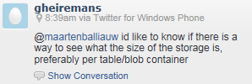



Tweets

Slide 45
Takeaways
What to remember?

Slide 46
Takeaways
Cloud pricing != more complex
Just “different”
Every component has own characteristics
Requirements impact costs
Developers impact costs
Windows Azure pricing model can improve code quality
But don’t over-analyze!

Slide 47
Resources
Starting point:
http://www.azure.com
Steve Marx:
http://blog.smarx.com
Cloud Cover Show
http://channel9.msdn.com/Shows/Cloud+Cover

Slide 48
THANK YOU
Maarten Balliauw http://about.me/maartenballiauw http://blog.maartenballiauw.be @maartenballiauw

